Slide 1
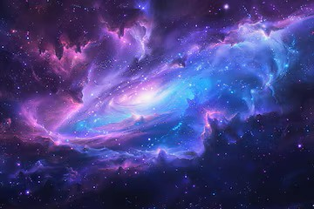
EXPLORING SPACE
From our solar system to universe
BY SHIVANGI
DEPARTMENT OF COMPUTER SCIENCE
ALIGARH MUSLIM UNIVERSITY
2026

Slide 2
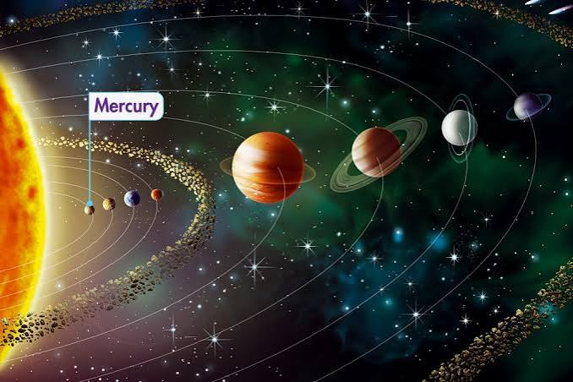
OUR SOLAR SYSTEM
The Solar System consists of the Sun and eight planets.
The planets orbit the Sun due to its gravitational force.
The eight planets are: Mercury, Venus, Earth, Mars, Jupiter, Saturn, Uranus and Neptune.
Jupiter is the largest planet.
Earth is the only known planet to support life.

Slide 3
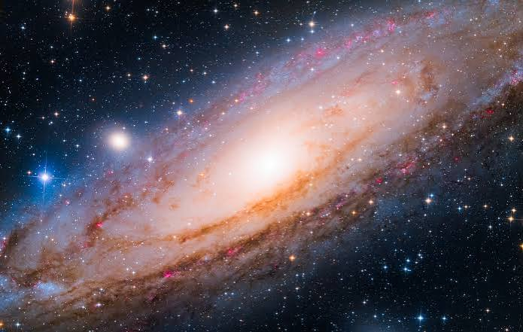
A UNIVERSE OF GALAXIES
A galaxy is a huge collection of stars, gas and dust held together by gravity.
Our galaxy is called the Milky Way.
The Milky Way contains billions of stars.
The universe contains billions of galaxies.
Galaxies can have different shapes, such as spiral, elliptical and irregular.

Slide 4
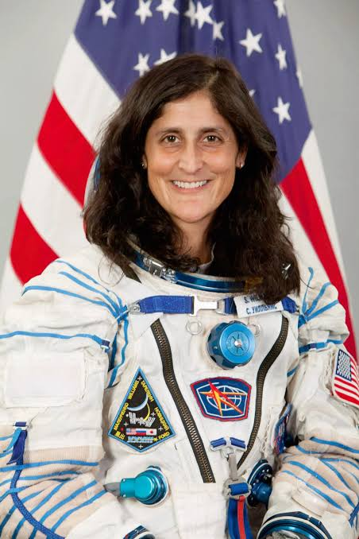
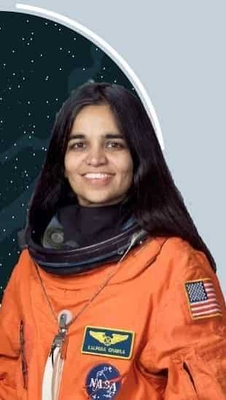
HUMANS BEYOND EARTH
1957 | First artificial satellite: Sputnik 1
1961 | First human in space: Yuri Gagarin
1969 | First humans on the Moon
1998 | International Space Station construction began
Today | Space telescopes, robotic missions & exploration

Slide 5
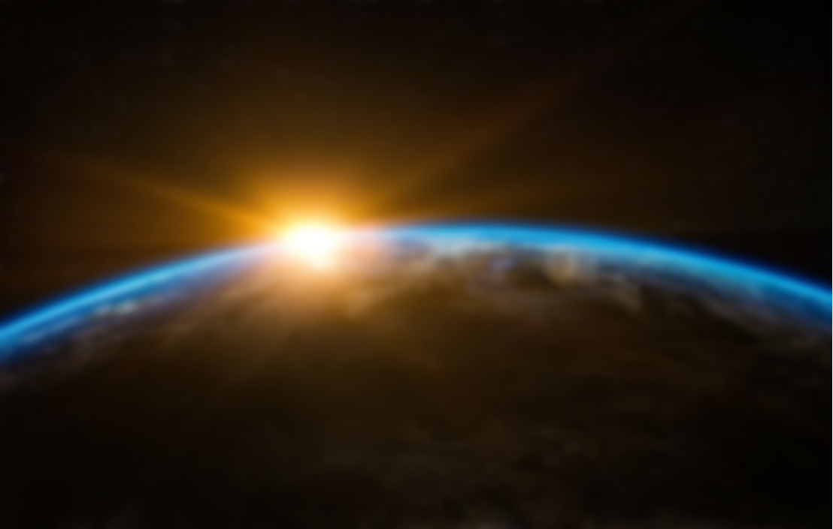
THE FUTURE IS BEYOND EARTH
More advanced space telescopes will help us study distant objects.
Scientists are searching for signs of life beyond Earth.
Humans may return to the Moon and eventually travel farther into space.
Reusable spacecraft could make space travel more accessible.
Space exploration will continue to expand our understanding of the universe.
Learn more about solar system
“The universe is under no obligation to make sense to you.”
— Neil deGrasse Tyson

